Slide 1
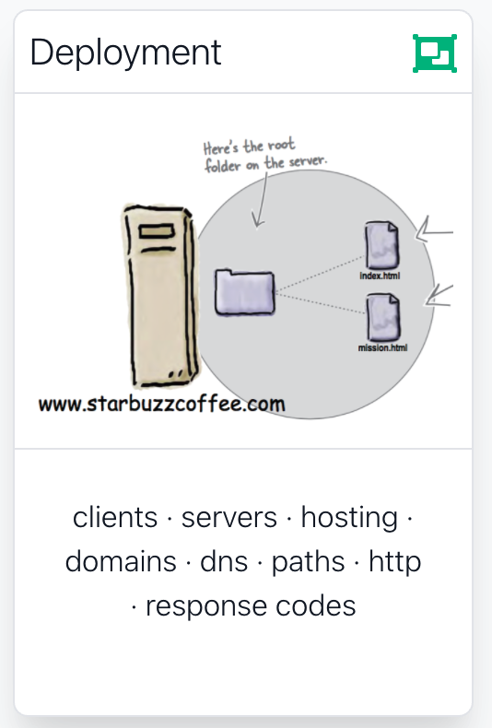

Slide 2

Deployment Issues
Clients & Servers
Hosting Providers
Domain Names
Transferring the Sites Files
HTTP
Absolute & Relative Paths

Slide 3
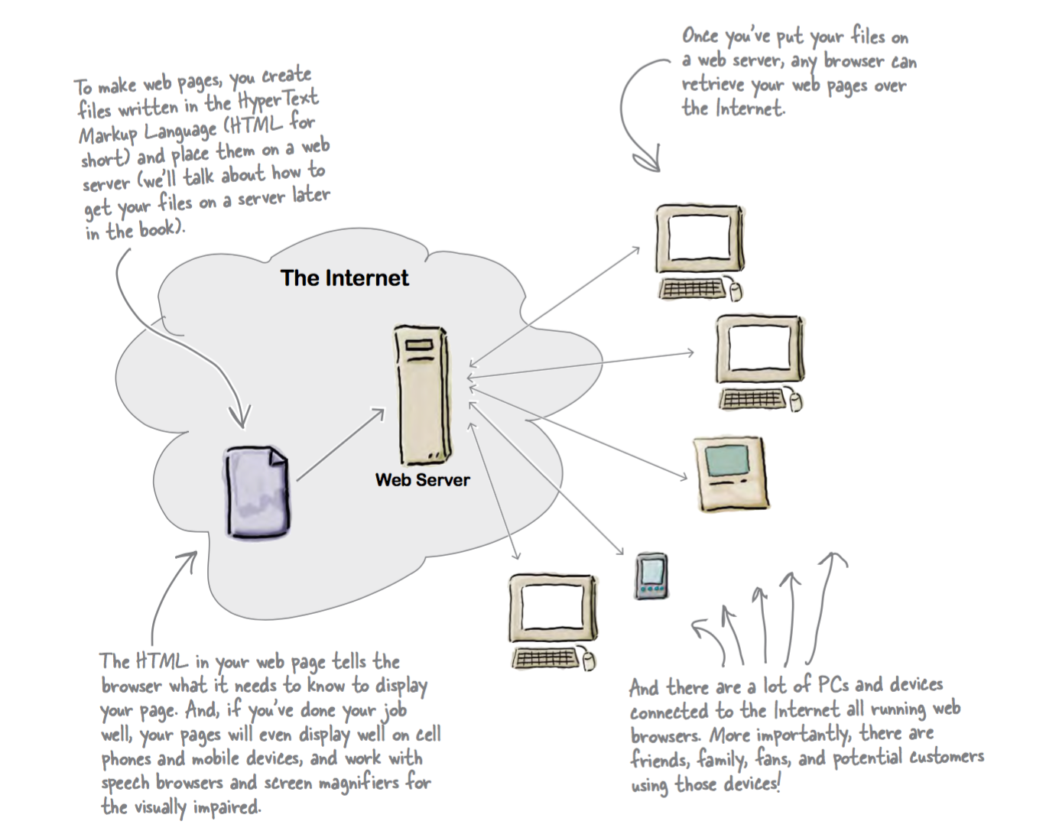

Slide 4
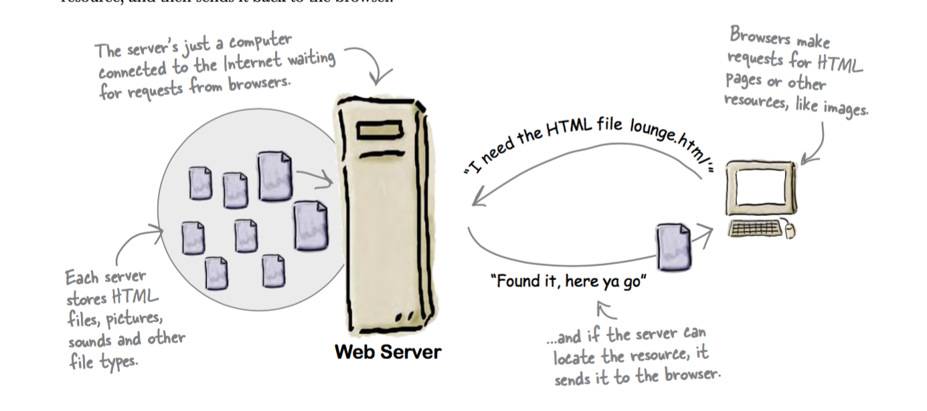

Slide 5
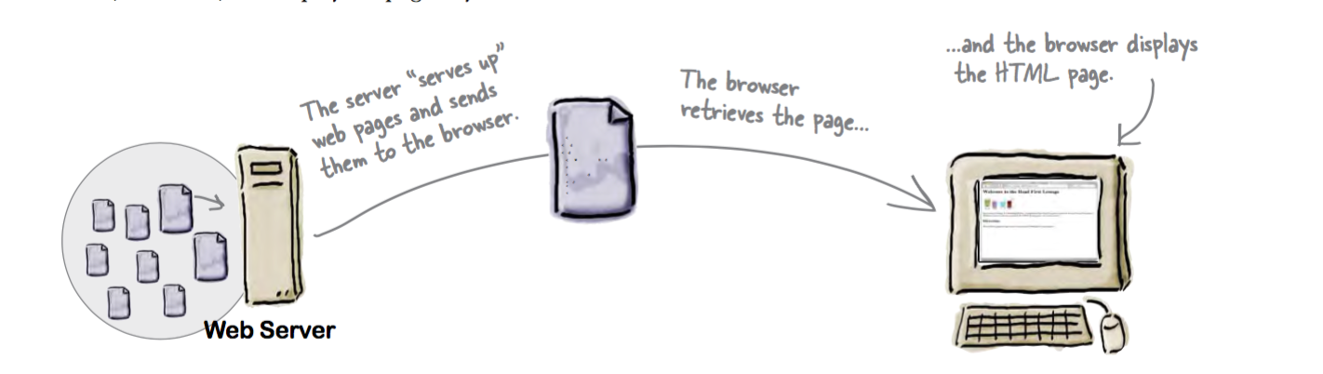

Slide 6



Hosting Company
To get your pages on the Web, you need a server that actually lives on the Web full-time.
Find a hosting company and let them worry about the details of keeping a server running.

Slide 7

Hosting Company Checklist
Technical support: Does the hosting company have a good system for handling your technical questions?
Data transfer: This is a measure of the amount of pages and data the hosting company will let you send to your visitors during a given month
Backups: Does the hosting company regularly make a backup of your pages and data that can be recovered in the event that the server has a hardware failure?
Domain names: Does the hosting company include a domain name in its pricing
Reliability: Most hosting companies report keeping websites up 99% of the time or better.
Add-ons: Does your package include other goodies such as email addresses, forums, or support for scripting languages

Slide 8
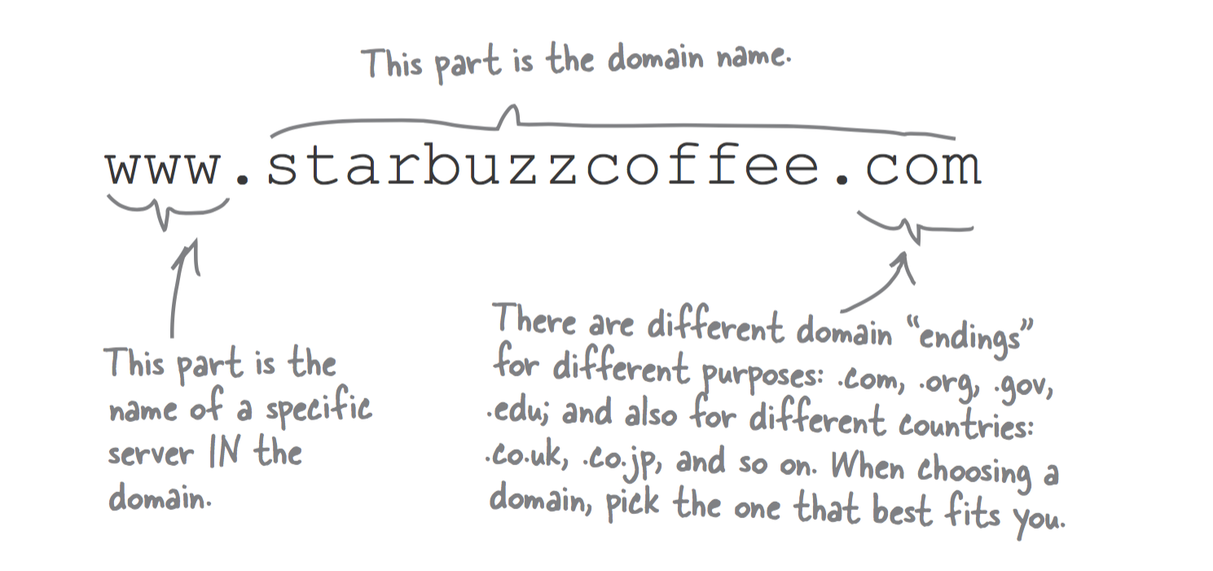
Domain Names

Slide 9

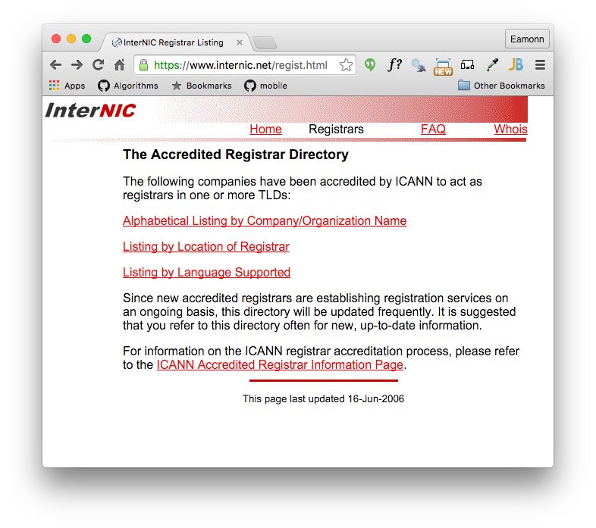
ICANN
Domain names are controlled by a centralized authority (ICANN) to make sure that only one person at a time uses a domain name.
Hosting Companies will often throw in your domain name registration with one of their package deals.
Register of domain name registration companies:
https://www.internic.net/regist.html

Slide 10


Slide 11
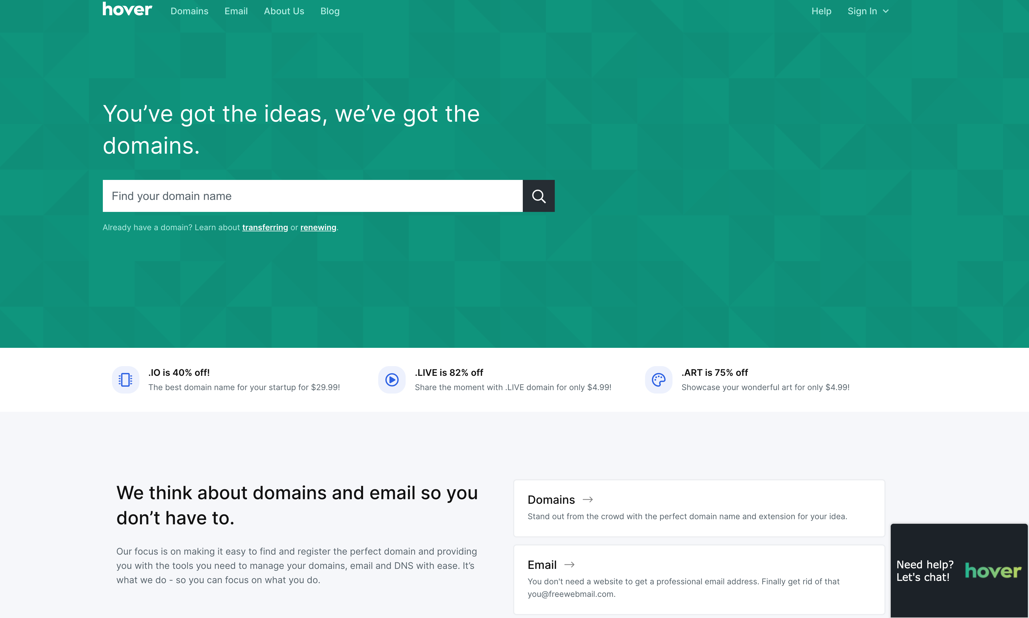

Slide 12
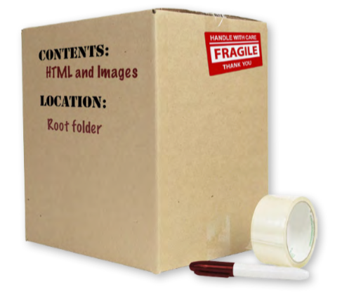
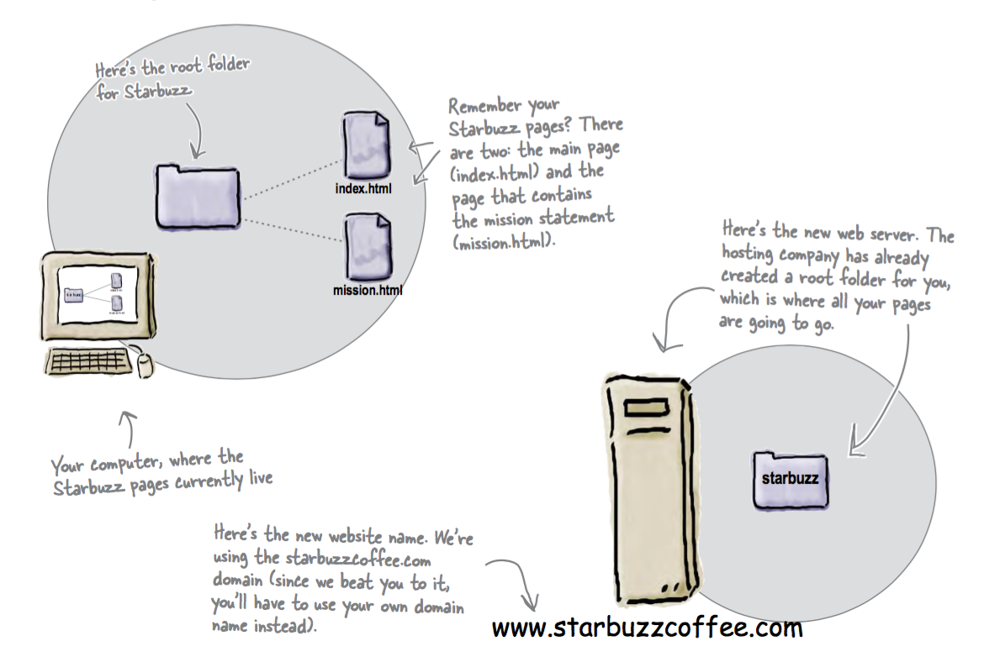
Moving Content

Slide 13
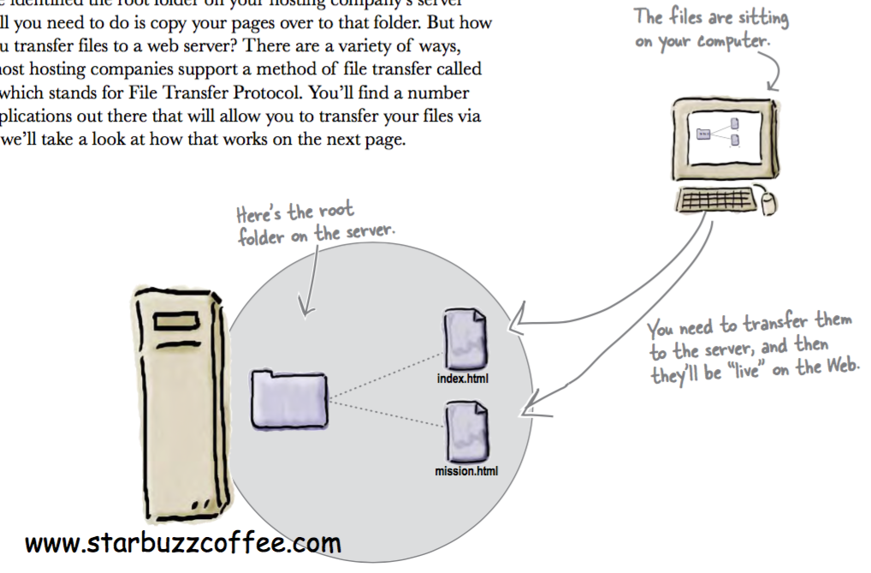

Slide 14

Transferring Files
Many Different Options:
FTP
Dropbox
WebDav
Git Push
Email Attachments
Etc…

Slide 15
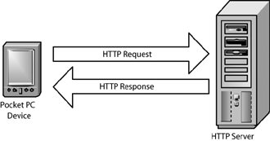
HyperText Transfer Protocol - HTTP
One Deployed - the site will be ‘served’ over HTTP to client browsers
An agreed-upon method (a protocol) for transferring hypertext documents around the Web.
While “hypertext documents” are usually just HTML pages, the protocol can also be used to transfer images, or any other file that a web page might need.

Slide 16
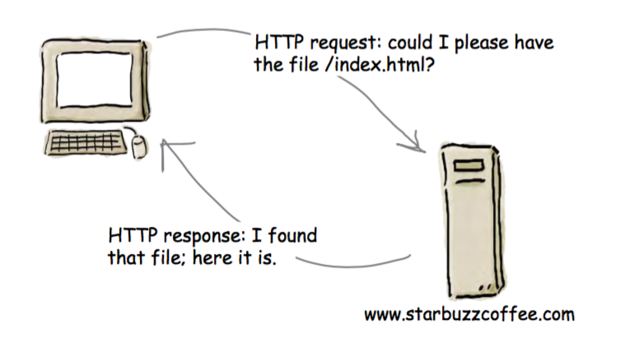
Each time you type a URL into your browser’s address bar, the browser asks the server for the corresponding resource using the HTTP protocol.
If the server finds the resource, it returns it to the browser and the browser displays it

Slide 17
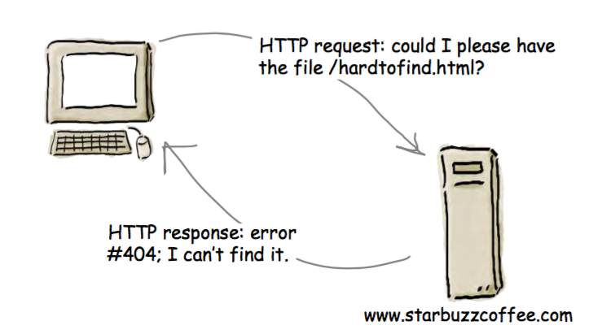
If the resource can’t be found, you’ll get the familiar “404 Error,” which the server reports back to your browser.

Slide 18
Absolute & Relative Paths
A Path is a series of folder or folders that specify a route to a specific file within a given folder tree structure.
An Absolute path always starts at the ‘root’, which is always denoted by the / symbol
A Relative path traces a route from the current director to a specific file. I may comment with:
. start at the current directory
.. go up one level
folder-name - start with the ‘folder-name’ in the current directory.

Slide 19
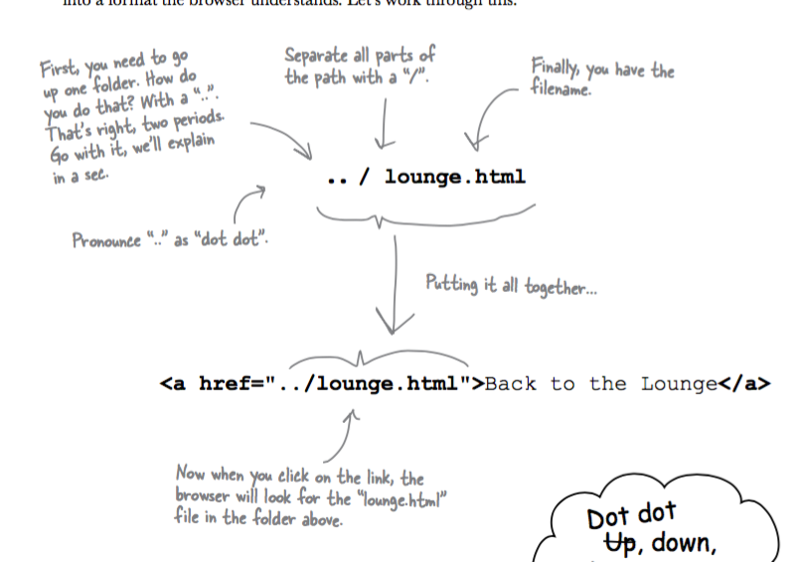
Relative Paths
../../
../../images/iot
Go up 2 levels
Go up 2 levels and then down into images and into iot

Slide 20
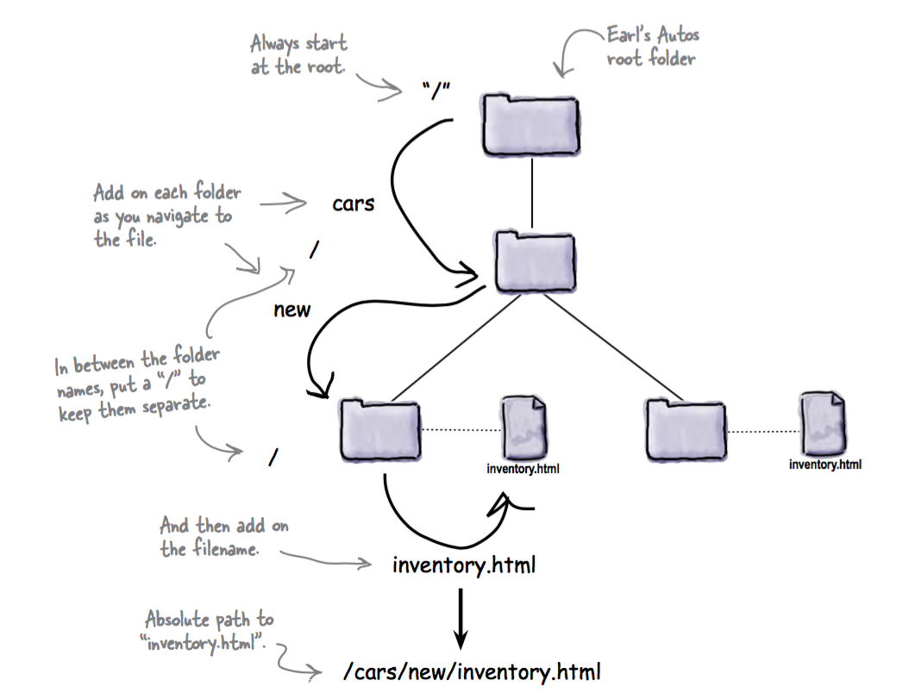
Absolute Paths

Slide 21
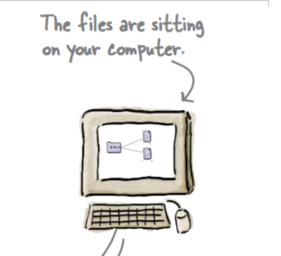
Paths on Local Web Sites
When a site is loaded directly into a browser on a local machine (as you have been doing so far):
You cannot reliably use absolute paths
If you do, then the site all be tied to the specific disk structure on your computer.
E.g. ‘/images/main.png’ may translate to
‘C:\MyDocuments\Web\project\images\main.png
This site will not be usable on other computers.

Slide 22
Paths for Deployed Sites
You can reliably use absolute paths
They will resolve to the Root folder of your project
This can be more convenient to manage the sites links
However, the site can only then be browsed via a server - it cannot be loaded from disk directly

